Slide 1
ATAI
Advanced Technique of Artificial Intelligence
ATAI
ChongqingUniversity _{AdvancedTechniqueof}
of Technology Artificial Intelligence
Chongqing University of
Technology
Chongqing University ^{ATAI}
_{of Technology} Advanced Techniqueof
Artificial Intelligence
Chongqing University of Technology
Chongqing University of Technology
Towards Learnable Anchor for Deep Multi-View Clustering
Code : None.
—— AAAI2025
Reported by Jing Li
1

Slide 2
ATAI
Advanced Technique of Artificial Intelligence
ATAI
ChongqingUniversity _{AdvancedTechniqueof}
of Technology Artificial Intelligence
Chongqing University of
Technology
Chongqing University ^{ATAI}
_{of Technology} Advanced Techniqueof
Artificial Intelligence
Chongqing University of Technology
Chongqing University of Technology
Introduction
1、 Anchor-based graph learning mainly rely on random selection and k-means to determine the final anchors, which means the anchors are not learnable and they may deviate from the true cluster distribution. Consequently, the unreliable anchors may corrupt clustering results.

Slide 3
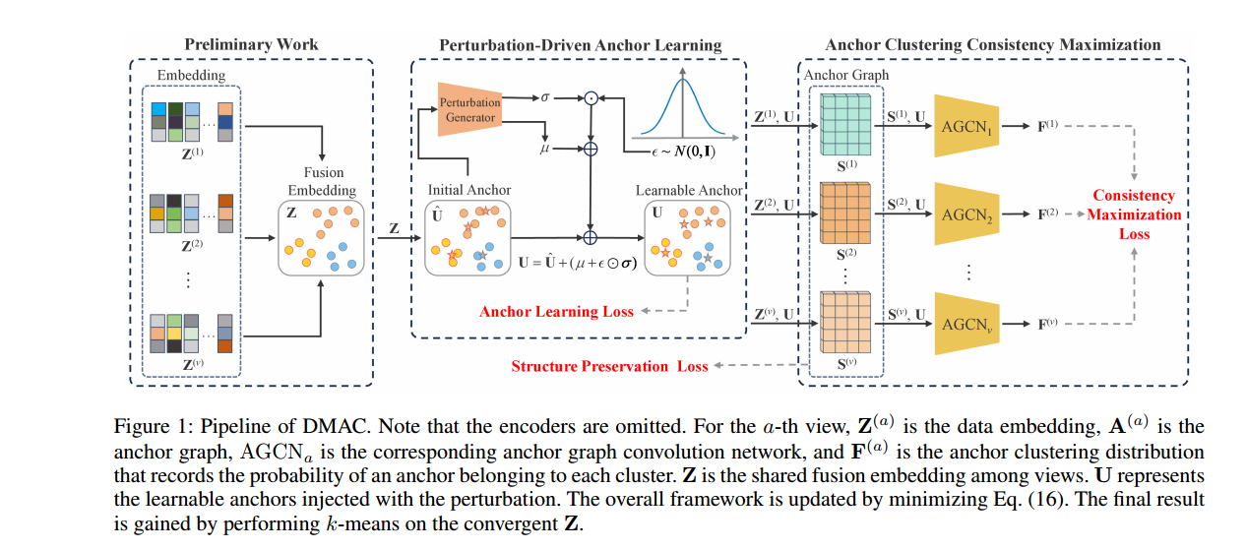
ATAI
Advanced Technique of Artificial Intelligence
ATAI
ChongqingUniversity _{AdvancedTechniqueof}
of Technology Artificial Intelligence
Chongqing University of
Technology
Chongqing University ^{ATAI}
_{of Technology} Advanced Techniqueof
Artificial Intelligence
Chongqing University of Technology
Chongqing University of Technology
Overview

Slide 4
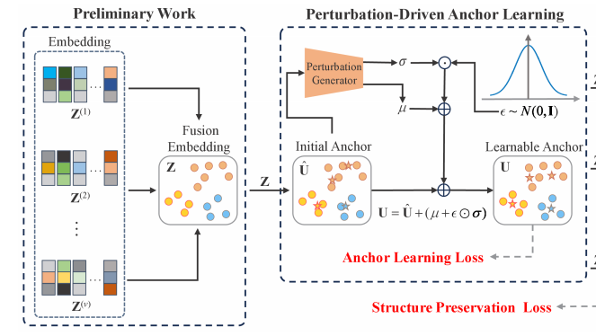
ATAI
Advanced Technique of Artificial Intelligence
ATAI
ChongqingUniversity _{AdvancedTechniqueof}
of Technology Artificial Intelligence
Chongqing University of
Technology
Chongqing University ^{ATAI}
_{of Technology} Advanced Techniqueof
Artificial Intelligence
Chongqing University of Technology
Chongqing University of Technology
Method

Slide 5
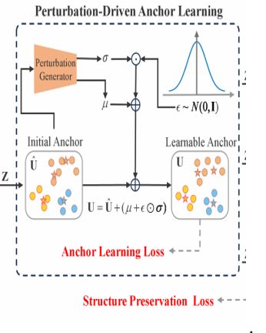
ATAI
Advanced Technique of Artificial Intelligence
ATAI
ChongqingUniversity _{AdvancedTechniqueof}
of Technology Artificial Intelligence
Chongqing University of
Technology
Chongqing University ^{ATAI}
_{of Technology} Advanced Techniqueof
Artificial Intelligence
Chongqing University of Technology
Chongqing University of Technology
Method

Slide 6
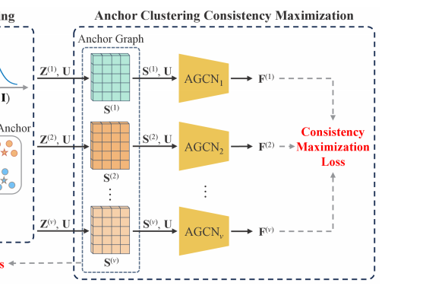
ATAI
Advanced Technique of Artificial Intelligence
ATAI
ChongqingUniversity _{AdvancedTechniqueof}
of Technology Artificial Intelligence
Chongqing University of
Technology
Chongqing University ^{ATAI}
_{of Technology} Advanced Techniqueof
Artificial Intelligence
Chongqing University of Technology
Chongqing University of Technology
Method

Slide 7
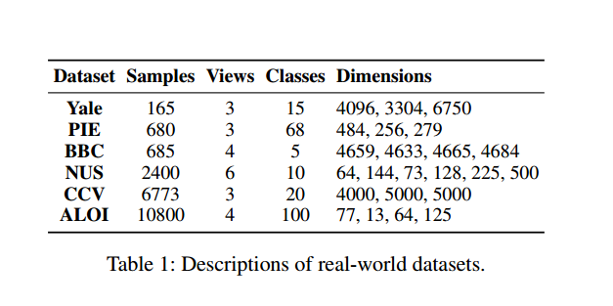
ATAI
Advanced Technique of Artificial Intelligence
ATAI
ChongqingUniversity _{AdvancedTechniqueof}
of Technology Artificial Intelligence
Chongqing University of
Technology
Chongqing University ^{ATAI}
_{of Technology} Advanced Techniqueof
Artificial Intelligence
Chongqing University of Technology
Chongqing University of Technology
Experiments

Slide 8
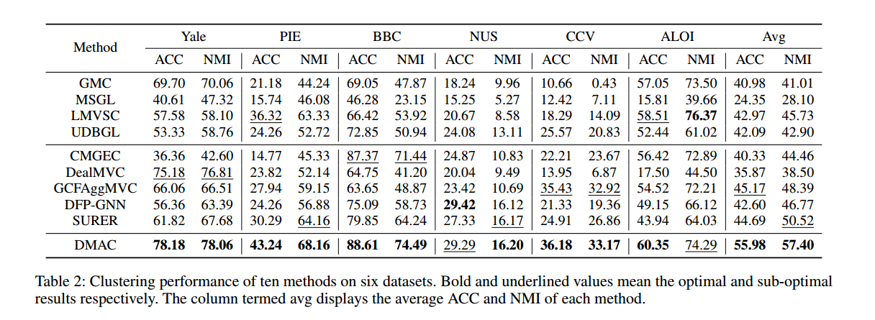
ATAI
Advanced Technique of Artificial Intelligence
ATAI
ChongqingUniversity _{AdvancedTechniqueof}
of Technology Artificial Intelligence
Chongqing University of
Technology
Chongqing University ^{ATAI}
_{of Technology} Advanced Techniqueof
Artificial Intelligence
Chongqing University of Technology
Chongqing University of Technology
Experiments

Slide 9
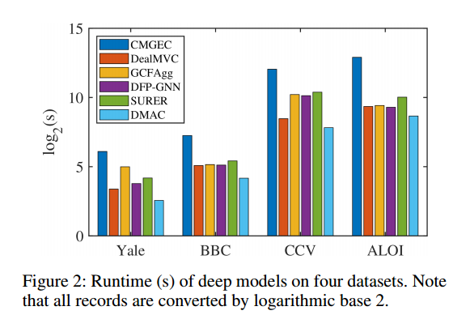
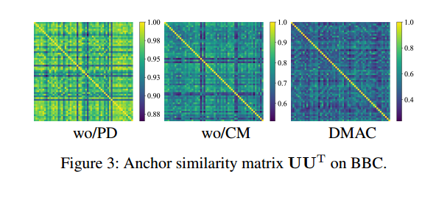
ATAI
Advanced Technique of Artificial Intelligence
ATAI
ChongqingUniversity _{AdvancedTechniqueof}
of Technology Artificial Intelligence
Chongqing University of
Technology
Chongqing University ^{ATAI}
_{of Technology} Advanced Techniqueof
Artificial Intelligence
Chongqing University of Technology
Chongqing University of Technology
Experiments

Slide 10
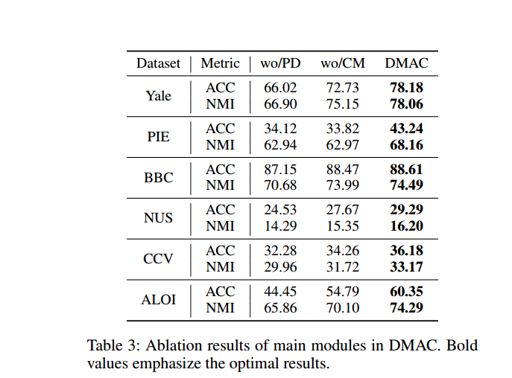
ATAI
Advanced Technique of Artificial Intelligence
ATAI
ChongqingUniversity _{AdvancedTechniqueof}
of Technology Artificial Intelligence
Chongqing University of
Technology
Chongqing University ^{ATAI}
_{of Technology} Advanced Techniqueof
Artificial Intelligence
Chongqing University of Technology
Chongqing University of Technology
Experiments

Slide 11
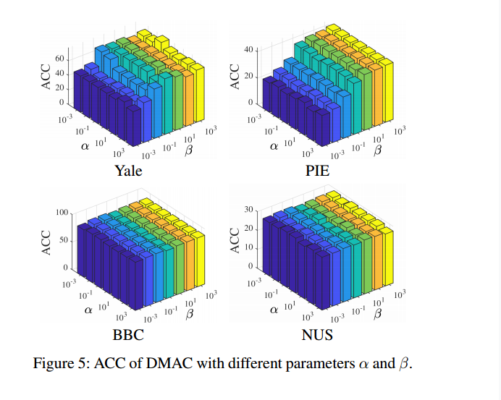
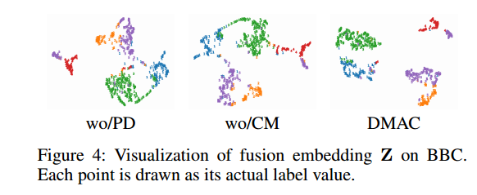
ATAI
Advanced Technique of Artificial Intelligence
ATAI
ChongqingUniversity _{AdvancedTechniqueof}
of Technology Artificial Intelligence
Chongqing University of
Technology
Chongqing University ^{ATAI}
_{of Technology} Advanced Techniqueof
Artificial Intelligence
Chongqing University of Technology
Chongqing University of Technology
Experiments

Slide 12
ATAI
Advanced Technique of Artificial Intelligence
ATAI
ChongqingUniversity _{AdvancedTechniqueof}
of Technology Artificial Intelligence
Chongqing University of
Technology
Chongqing University ^{ATAI}
_{of Technology} Advanced Techniqueof
Artificial Intelligence
Chongqing University of Technology
Chongqing University of Technology
Thanks!

